Slide 1

Cupedia
Idea Pitching
Made by team- Elite4

Slide 2

Agenda
PROBLEM
REQUIREMENT OF SOLUTION
BUSINESS MODEL
MARKET PLAN
COMPETETIVE ANALYSIS
TEAM
FINANCIAL PROJECTIONS
CLOSING

Slide 3
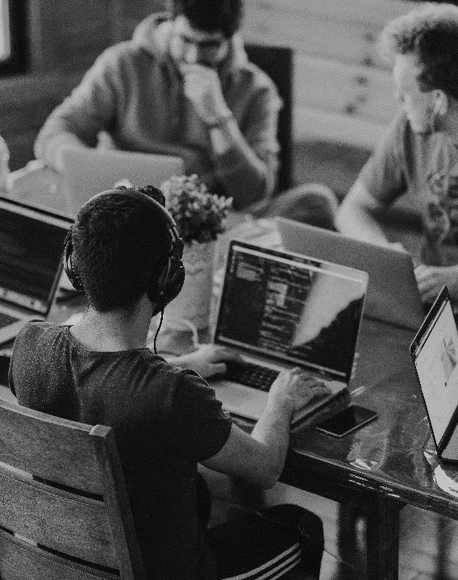
Problems
Faced by the Chitkara Students
As we all (team members) are also students, we know the pain of not finding the notes or previous year question papers . Most of the time when we search online for any notes or question papers we find that they are of any other college which has a very different curriculum.
So this becomes big pain for the students to collects the information from different sources.

Slide 4

WE HERE WILL TRY TO PROVIDE ALL THE NOTES AND THE PREVIOUS YEAR QUESTION PAPERS TO DIFFERENT BRANCH AND COURSE STUDENTS IN CHITKARA

Slide 5
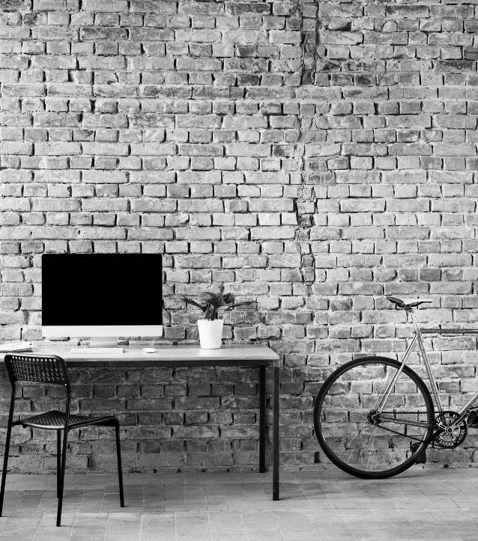
What’s next
LOOKING AHEAD

Slide 6


Goals for cupedia
MARKET PLAN
BUSINESS MODEL
First we will start with our friends to use the website for their help
Then with help of networking our product will get a reach
Next comes the help of Social Media which is the best platform to promote our work with all the students
We are a non profit organization.
The product works with the help of our consumers only.
The people seeking help or any other person can upload the resources other students looking for.

Slide 7



Contd.
COMPETITIVE ANALYSIS
Being the only one to provide such facility to the students of Chitkara University
Will try to be best if any such competition establishes in the future
ADDED PRIORITIES
Improve social media presence
Ensure the cost of development stays below budget
WORKING OPPORTUNITIES
Internship opportunities in different sectors in future
More opportunity to learn

Slide 8
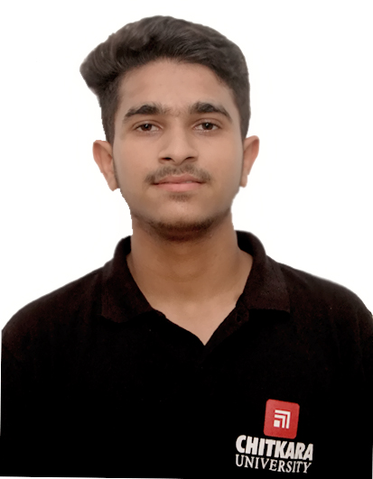
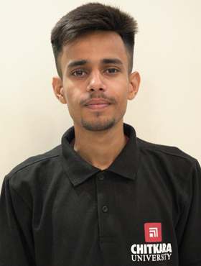
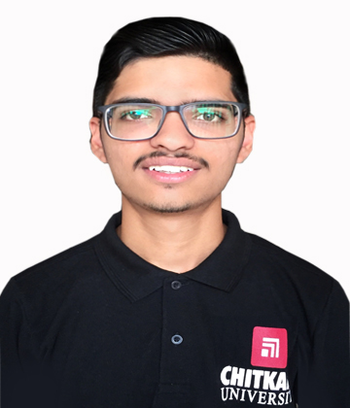
Meet the team
Suhit Gupta
Team Leader
Bhavuk Dhawan
Team Member
Ujjwal Sharma
Team Member
Tanishq Sehra
Team Member

Slide 9

SUMMARY
PROBLEMS FACED BY THE STUDENTS
SOLUTIONS PROVIDED TO CONSUMERS
GOALS OF CUpedia
MEET OUT TEAM

Slide 10
THANK YOU
CUpedia - Team Elite4

